Slide 1

CIS-4951
With Dr. Bruce Maxim
Sky Socket
Software Design Specification
Demetrius Johnson
Ryan Sauer
Olivia Pellegrini
Jonathan Schall

Slide 2

1 Introduction
Goals and Objectives
Accurately detect a potential hazard in multiple environments using sensors from the car and drone, particularly the vision systems (camera).
Maximize drone battery life and bandwidth, while minimizing latency (response time of the car to commands and information sent from the drone).
Develop a working product that is open source and reproducible through our documentation to serve as a future reference/baseline for further research.
Statement of Scope
An image recognition algorithm running on the drone for detecting predefined objects
A manual/automatic control mechanism for the car.
A manual/automatic control mechanism for the drone.
A communication channel between the car and drone (for sending commands).
A side communication channel for the car and drone (for data collection).
An image processing offloading (from the drone to the car) algorithm for the drone.
A log system to record data points about the drones battery life, bandwidth, and latency.
A GUI-based interface that can be run on a remote device to control the drone and car system (run experiment) as well as record logs.
Notes:
meech

Slide 3
1 Introduction
Software context
We will be applying software to a drone and car for research purposes. It is not intended to be widely available and only used by researchers for data creation and analysis. It is also meant to be used in a controlled environment with simple scenarios for gathering data.
Major Constraints
PiCAR-x and Clover Drone
No extra Raspberry-Pi’s
Car came later than anticipated, delaying start
Policies make comprehensive testing limited in scope and possibility
2 Data Structures
2.1 Internal software data structure
Our program is designed to allow data to flow through. We are utilizing the JSON module to listen to a data stream from the drone, and actively append to a file for the user.
2.2 Global data structure
Receiving JSON data from input streams that are written to the GUI
2.3 Temporary data structure
Many of our temporary files are user defined. Other generated temporary files are stored in /tmp/ inside Linux.
Notes:
meech

Slide 4
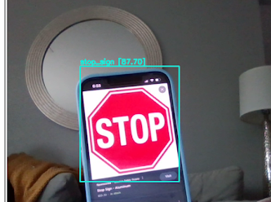
3 Architecture and component-level design
Our Software Components:
(1) Object Detection Algorithm
Purpose: this is used to detect our desired classes, (stop signs for example), from video frames collect from the drone’s camera. We use Darknet, an open source software, as a way to train our objects for detection. The YOLOv4-tiny model can take our input as a jpeg images and an XML files with bounding box coordinates to train our models. We use these images and XML files in Darknet to create weight files to be used in later programs to provide object detection accuracy.
I/O: The input is jpeg and XML images of the object and bounding
boxes. We also need a weights file which contain the best weights
from training the data set. During training, we also needed a
configuration file as input. The output includes bounding boxes with a
confidence level percentage for detection that are overlaid on our
video frames.
(2) Data Collection
Purpose: The data we need to collect can be taken from the
drone and car. This includes things such as battery status, network
status, etc. For this, we can just implement file write in Python to
get these variables and display them in a txt file for users to easily
read and then close the file after we are done running the experiment.
I/O: The data collect takes input from the drone and the output
is a txt file that contains status information.
Testing on Webcam in Google Colab
Notes:
meech

Slide 5
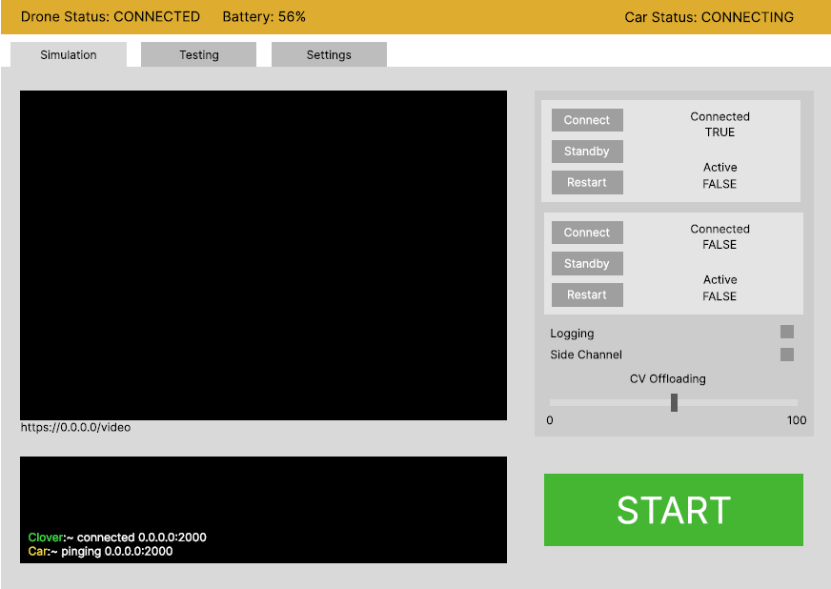
3 Architecture and component-level design (continued)
(3) GUI
Purpose: Provides an easy to use interface for the user
to run the experiment. (Discussed more later)
I/O:The input relies on the user to press buttons that will send
parameters to the drone to conduct the experiment or connect.
The output would be the results of the what action the user chooses
from the GUI, which could be actually running/connecting to the drone.
(4) Drone Programs
(a)Video recording: Initiates and allows video frames to continuously be captured from the drone’s camera with a timestamp (via ros subscriber topic)
(a) I/O: The programs takes input from the user of the path they want to save the video, and the output is the videos frames being displayed/saved to the path (ros publisher).
(b)Flying the drone: Send commands to the FCU, receive feedback from sensors.
(b) I/O: clover SDK runs on the pi → controls FCU.
(5) Car/Drone Communication Program
Purpose: Allows car and drone to form a connection and allow communication. The car is able to receive commands from the drone to stop. It can also control the speed at which the car drives. The client (drone) is able to send commands such as slowing down, turning right or left, adjusting speed or stopping to the server (car).
I/O: We need the server IP and port to allow connection from the drone to the car. Input to the server comes from the client in the form of a warning. The server (car) can execute these commands to avoid obstacles.
Notes:
meech

Slide 6
4 UI Design
Interface design is focused on making our product easier to use and to allow users to control the whole system from a single point of view.
Design Rules:
Easy to understand
Flexible
Give verbose feedback
UIDS used is Kivy in Python. It allows for fairly reactive programs and most standard components for modern UI. Some menus aren’t to our UI design goals, such as the file system menu. Because of this, we are using win32ui for file dialogs. Our UI is intended only for Windows and modern systems, so the limitations this provides do not impact our intended user base.
Notes:
meech

Slide 7
4 UI Design
Notes:
meech

Slide 8
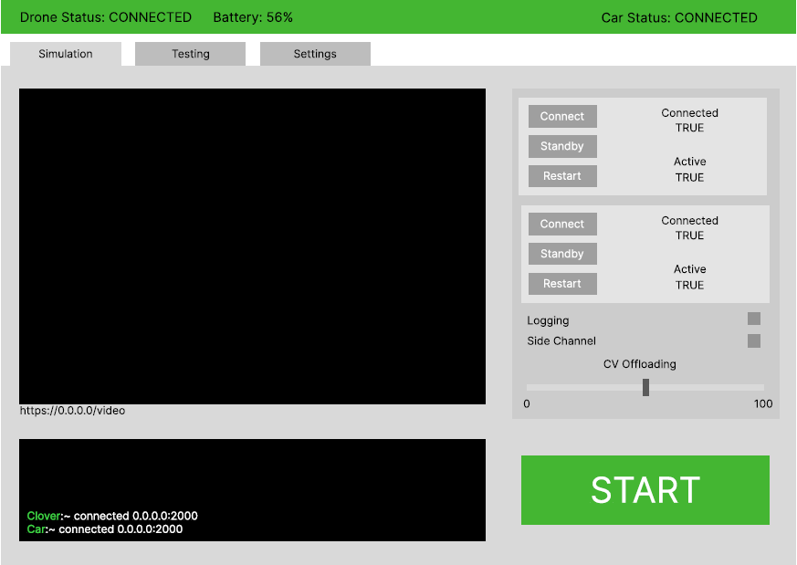
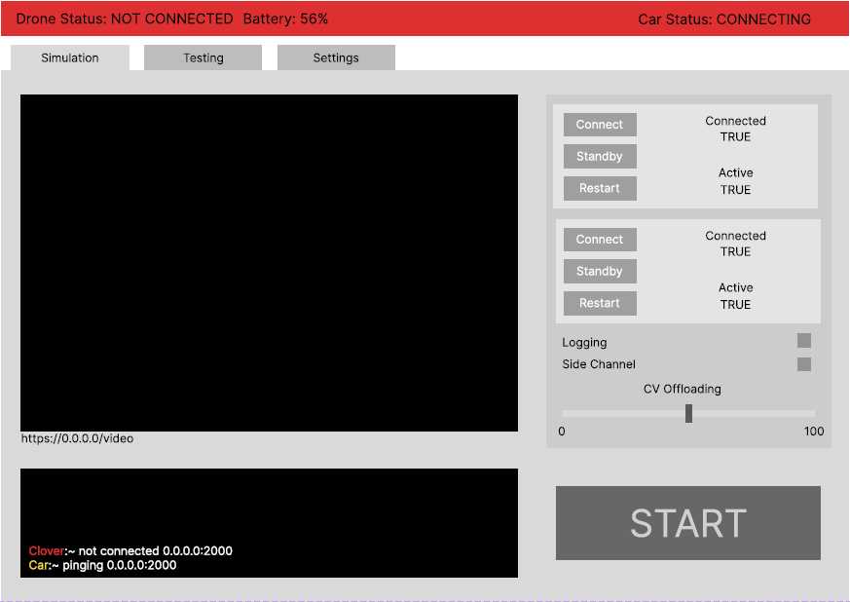
4 UI Design
Notes:
meech

Slide 9
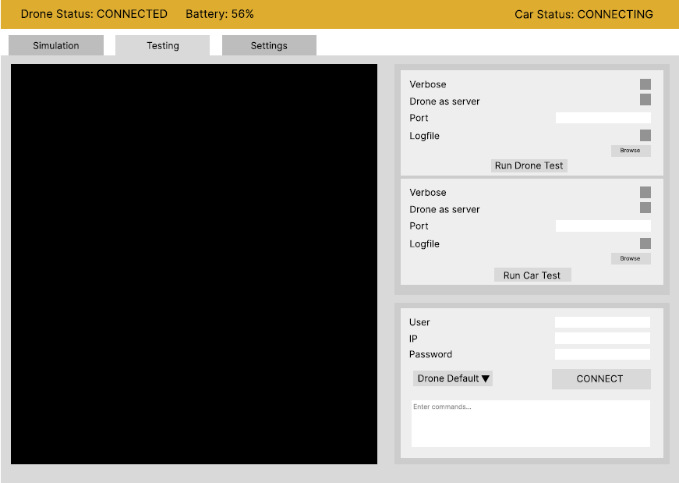
4 UI Design
Notes:
meech

Slide 10
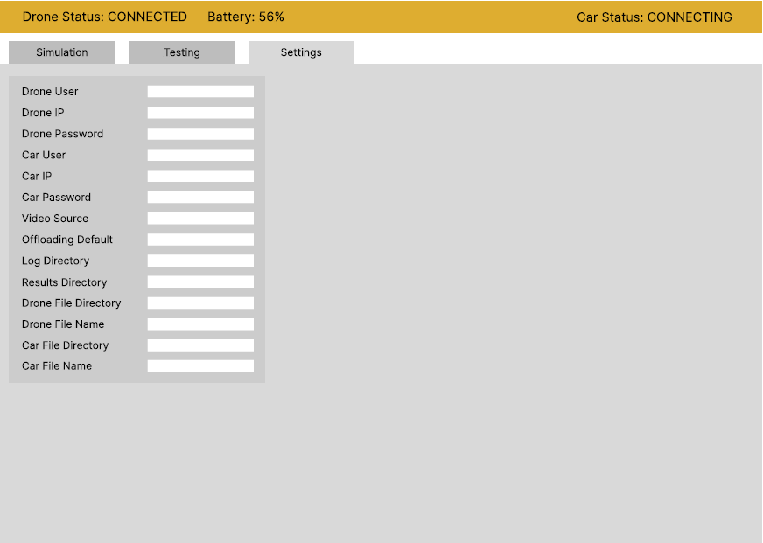
4 UI Design
Notes:
meech

Slide 11
5 Restrictions
Time:
We only have two semesters to get the software, hardware, and tests done from scratch with little to no experience with the subject matter beforehand. We have a lot of possible additions to the scope, but we may be limited by time. One of these additions is the addition of autonomous flight by the drone.
Expertise:
We are working with a lot of hardware and new interfaces/libraries we aren’t familiar with. We will have to use up time to learn how to use and work with these interfaces.
Access:
We have limited hardware (computing and vehicles) as well as limited access to them. We can work hands on with the drone and car when on campus and when we are given access to the testing facility, so we must be intentional about when we can be on campus and work with the hardware together.
Notes:
meech

Slide 12
6 Testing Issues
Classes of tests:
Unit Testing:
We will test each component of our system independently. We have test each program independently without the rest of the system to ensure each parts function. This is a combination of white and black box testing for the given component. Naturally our ML is mostly black box, and our GUI + software is mostly white box testing.
Integration Testing:
We have a lot of pieces that have to work together and talk. After we’ve ensured the quality of our components, we slowly test combinations. Combinations of the program will be systematically cleared using majority white box testing.
Functional Testing:
Once all parts are together, we will be running many black box tests to ensure the product is acceptable and functioning in all required aspects.
Notes:
meech

Slide 13
6 Testing Issues
Expected Results:
For our GUI and software, we expect efficient and user friendly behaviors. When buttons are pressed, there should be minimal lag without user feedback, non explicit queues should assist the user and the system should function consistently with any errors or issues being logged for the user
For the computer vision and offloading systems, we expect accurate and precise detection with effective offloading solutions. Our goal is to have a model with 90% mean average precision (mAP)
Performance Bounds:
Our GUI should have no more than 1 second lag times for button and form input to some form of user feedback. The system should begin it’s test within 10 seconds of initiating the test.
For our computer vision detection system, our system should reach a minimum of 80% mAP. The offloading should have no more than 10% packet loss at 100% offloading. If any of these goals are unattainable, research as to the cause needs significant effort and a written report for the client as to the reason for subpar standards.
Notes:
meech

Slide 14
6 Testing Issues
Critical Components
Car:
The car runs software for receiving offloaded video as well as information from the drone’s vision system.
Drone:
The drone runs as a wifi router for the system so all communication goes through the drone. In addition, the drone will run a CV detection algorithm that triggers communication to the car.
Object Detection Algorithm:
We are training a custom object detection algorithm that will require extensive testing and training to ensure it is up to standard. It will also require preparation and testing for both a server and embedded implementation. Both will then require more testing.
User Interface:
The user interface must communicate with the drone and car as well as display video, car output, and drone output. All functionality must be tested for use and efficiency. The UI program also holds the logic for logging which requires separate and thorough testing.
Notes:
meech

Slide 15
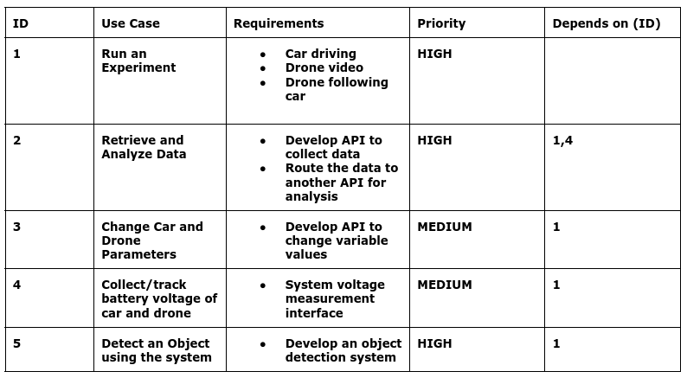
7 Traceability Matrix
Notes:
meech

Slide 16
Contact Us
Demetrius Johnson
meech@umich.edu
Ryan Saur
sauerr@umich.edu
Jonathan Schall
jcschal@umich.edu
Olivia Pellegrini
opelle@umich.edu
Dr. Zheng Song (Client)
zhesong@umich.edu
Dr. Bruce Maxim
Senior Design Professor/Director CIS-4951 Winter 2023
bmaxim@umich.edu

Slide 17
Research References
S. A. Hadiwardoyo, E. Hernández-Orallo, C. T. Calafate, J. -C. Cano and P. Manzoni, "Evaluating UAV-to-Car Communications Performance: Testbed Experiments," 2018 IEEE 32nd International Conference on Advanced Information Networking and Applications (AINA), Krakow, Poland, 2018, pp. 86-92, doi: 10.1109/AINA.2018.00025.
URL: https://ieeexplore.ieee.org/stamp/stamp.jsp?tp=&arnumber=8432227&isnumber=8432202
J. Yoon, I. Kim, W. Chung and D. Kim, "Fast and accurate car detection in drone-view," 2016 IEEE International Conference on Consumer Electronics-Asia (ICCE-Asia), Seoul, Korea (South), 2016, pp. 1-3, doi: 10.1109/ICCE-Asia.2016.7804775.
URL: https://ieeexplore.ieee.org/stamp/stamp.jsp?tp=&arnumber=7804775&isnumber=7804716
Yildiz, Melih, Burcu Bilgiç, Utku Kale, and Dániel Rohács. 2021. "Experimental Investigation of Communication Performance of Drones Used for Autonomous Car Track Tests" Sustainability 13, no. 10: 5602.
URL:
https://doi.org/10.3390/su13105602
Barbeau, Michel, Joaquin Garcia-Alfaro, and Evangelos Kranakis. 2022. "Research Trends in Collaborative Drones" Sensors 22, no. 9: 3321.
URL:
https://doi.org/10.3390/s22093321
Textbook: Software Engineering A PRACTITIONER'S APPROACH EIGHTH EDITION, by Roger S. Pressman, Ph.D. and Bruce R. Maxim, Ph.D.
Notes:
meech

